Slide 1
19AIE205
PYTHON FOR MACHINE LEARNING
OBJECT DETECTION USING R-CNN
TEAM 04

Slide 2
Team Members
Ameen Ashadullah
Gokul R
Bhoomika M
GHaayathri Devi K

Slide 3
TABLE OF CONTENTS
01
02
03
04
05
06
07
INTRODUCTION ON OBJECT DETECTION
CNN
RCNN
SVM ALGORITHM
Limitations of rcnn
CODE EXPLANATION
CONCLUSION

Slide 4
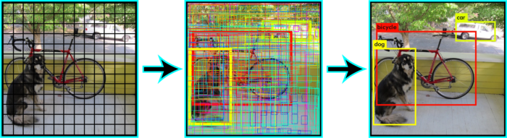
INTRODUCTION to object detection

Slide 5

Convolutional Neural Networks (CNNs)

Slide 6
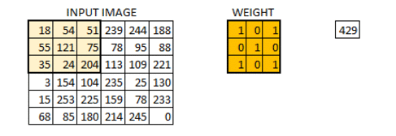
The Convolution Layer

Slide 7
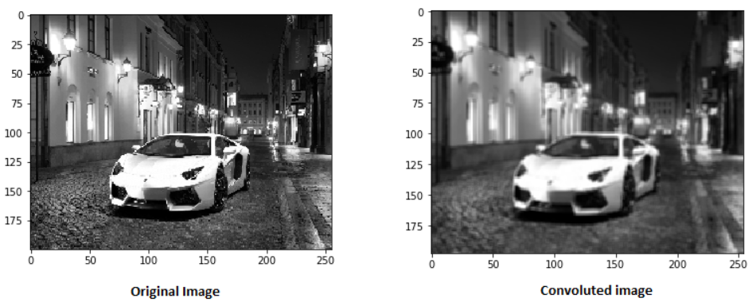

Slide 8
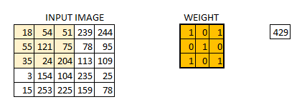
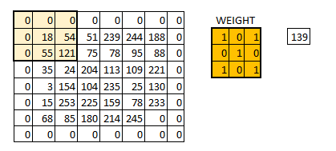
Stride
Padding

Slide 9
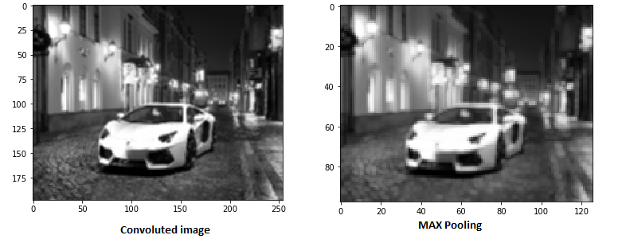
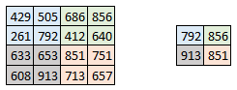
The Pooling Layer
Sometimes when the images are too large, we would need to reduce the number of trainable parameters. It is then desired to periodically introduce pooling layers between subsequent convolution layers. Pooling is done for the sole purpose of reducing the spatial size of the image.

Slide 10
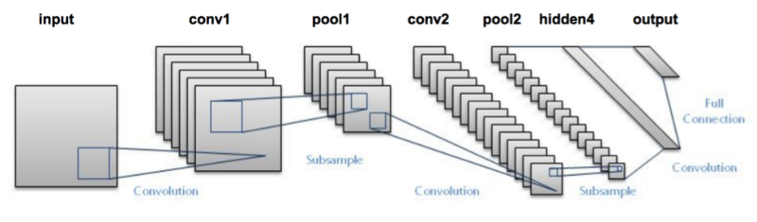
Putting it all together

Slide 11
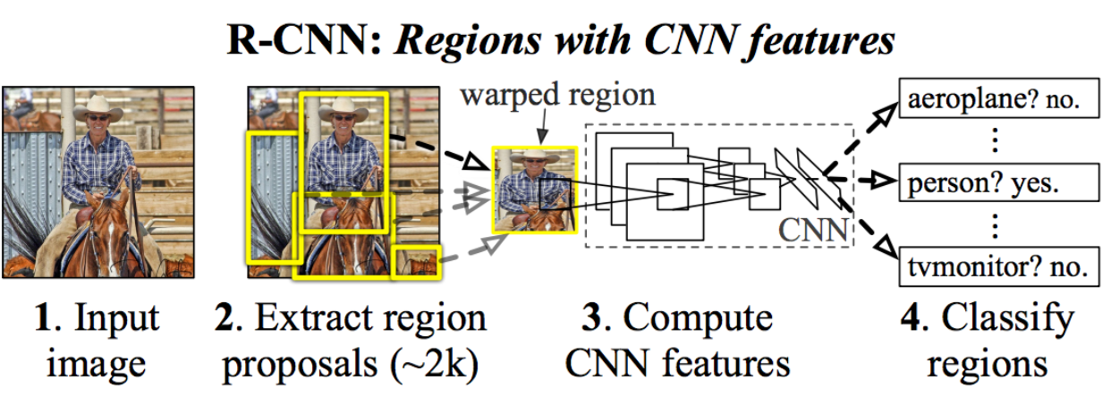
R-CNN

Slide 12
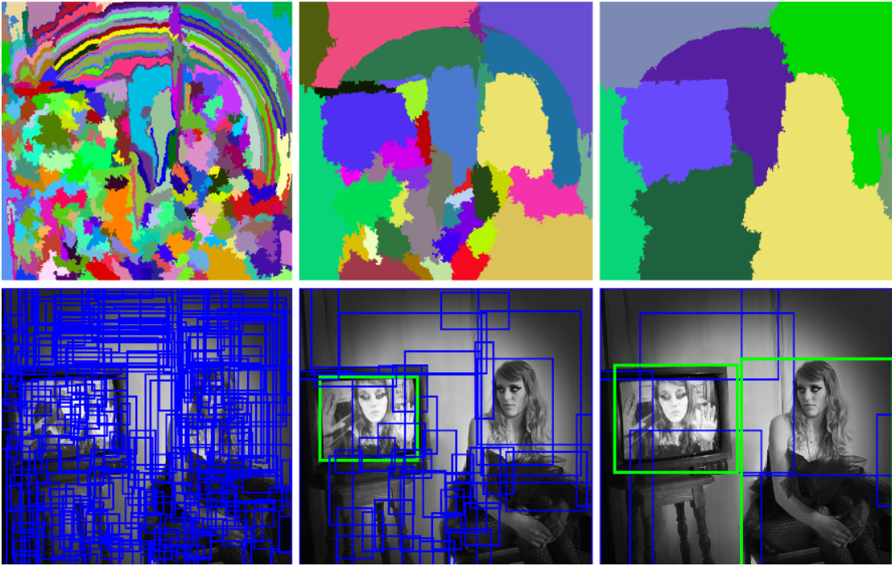
selective search
Notes:
Selective Search is a region proposal algorithm used in object detection. It is designed to be fast with a very high recall. It is based on computing hierarchical grouping of similar regions based on color, texture, size and shape compatibility.

Slide 13
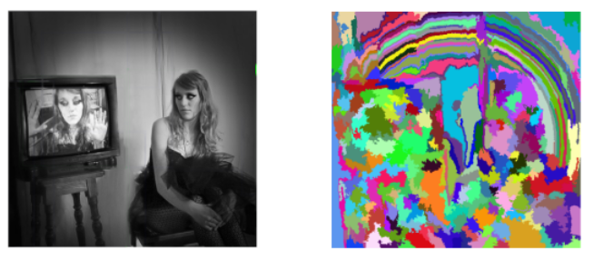
STEP 1: Generate initial sub-segmentation of input image

Slide 14
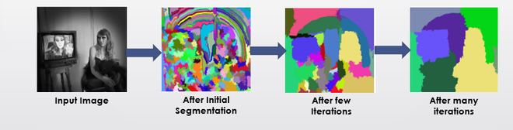
STEP 2:
Recursively combine the smaller similar regions into larger ones.
Greedy Algorithm :
1. From set of regions, choose two that are most similar.
2. Combine them into a single, larger region.
3. Repeat the above steps for multiple iterations.

Slide 15
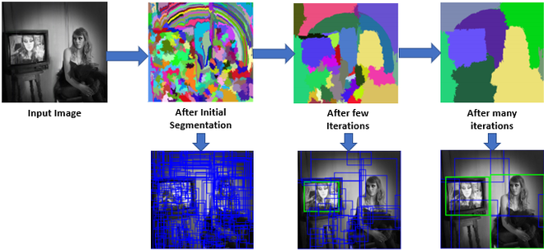
STEP 3:
Use the segmented region proposals to generate candidate object locations

Slide 16
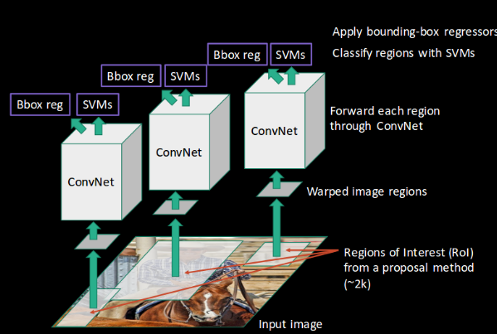

Slide 17
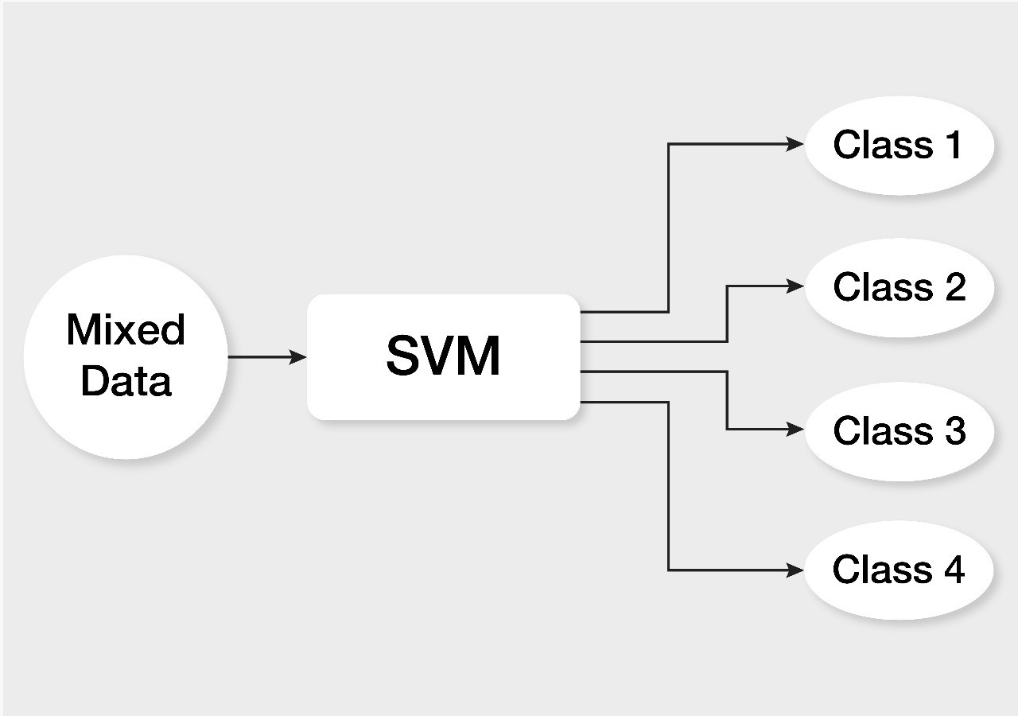
SVM CLASSIFIER

Slide 18
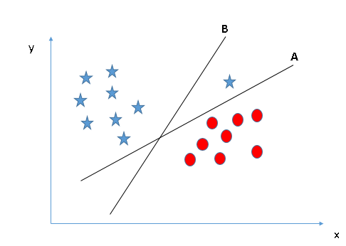
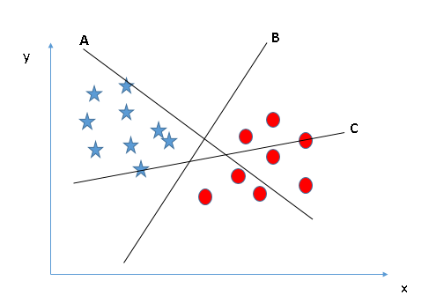
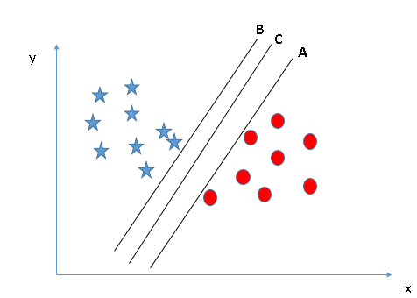
HOW DOES IT WORK ?
STEP 3
STEP 1
STEP 2

Slide 19
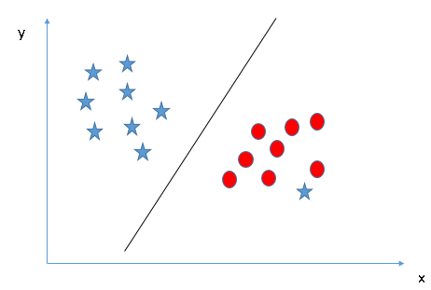
FINAL STEP

Slide 20
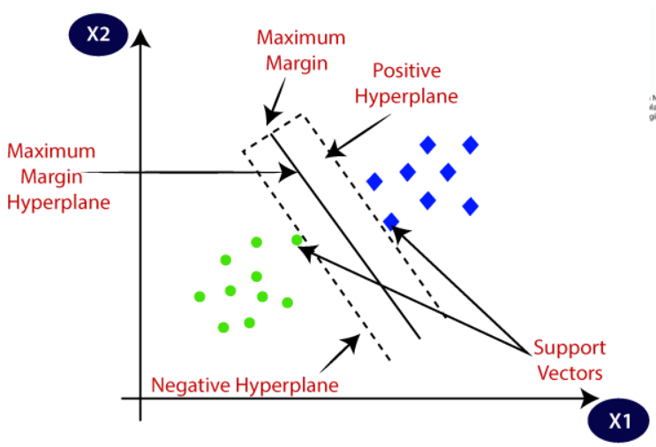

Slide 21
EXPLAINING THE PROCESS

Slide 22
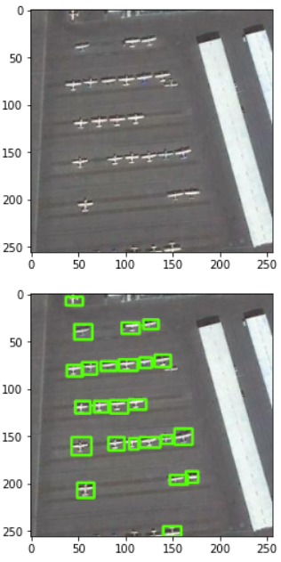
Reading and Segmentation of the image From Dataset
Notes:
Coordinates of diagonals of each rcatangle using cv2 function.
Annotation file.
Using rcn diagonals tharum

Slide 23
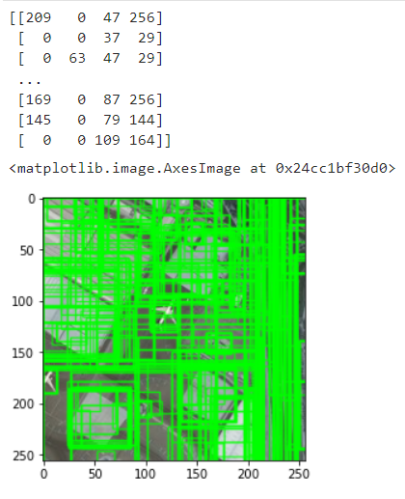
Selective search segmentation using the cv2 module.
we will get the coordinates for the N Regions Segmented
Notes:
Shape, color structure.
Using first 2000
Region of interest(ROI)

Slide 24
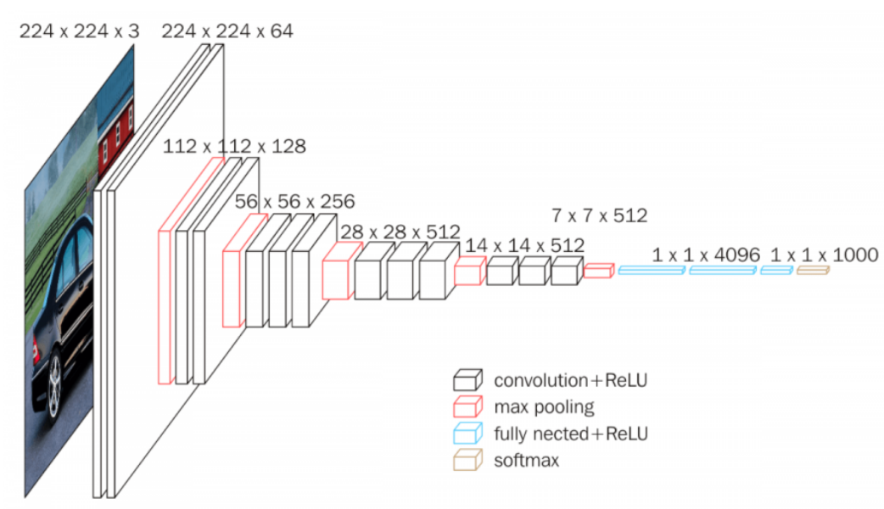
Notes:
For object detection and classification through layerwise computation, we use VGG neural Network .l

Slide 25
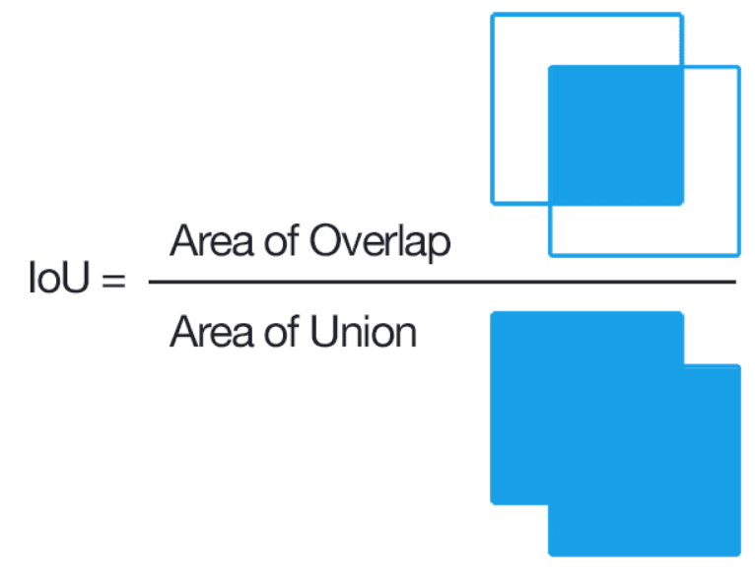
Let BB1 be the region given from dataset
BB2 be the region we go from the selective search algorithm 1. Find the area of BB1
2. Find the area of BB2
3. Finding intersection between them
4. Finding the union region
(A(BB1)+A(BB2)-A(INTERSECTION))
5. We find the Intersection Over Union, IOU= Area of Intersection/Area of Union
Notes:
For each image after getting segmented regions(more than 2000), We Compute its Intersection over Union areas with the annotated region given in dataset

Slide 26
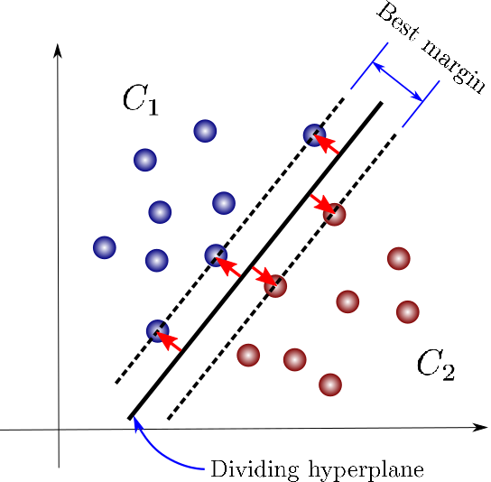
Notes:
In SVM Layers, there will be SVM Image and SVM Label. The SVM Label is determined by IOU Where IOU > 0.7 => True Counter If IOU < 0.3 => False Counter
Finally we replace the last 2 layers of 1st model with the SVM Layers. And we will the train the model.

Slide 27
01
02
03
04
CODE OVERVIEW:
The datasets used are images(Aeroplane) AND Annotations(coordinates)
Applying Selective search segmentation algorithm
Getting IOU Values
Training the neural network Using the VGG16 Neural Network

Slide 28
01
02
03
04
Applying SVM to the Data set
Replacing The Last 2 Layers of Neural Network with SVM layers
Finally Training the data and storing the model in saved model format .h5
Testing the Model and we get the plotting of loss, Validation Loss and the Prediction of Ojects Detected in image

Slide 29
CODE

Slide 30
LIMITATIONS OF RCNN:
Extracting 2,000 regions for each image based on selective search
Extracting features using CNN for every image region. Suppose we have N images, then the number of CNN features will be N*2,000
The entire process of object detection using RCNN has three models:
CNN for feature extraction
Linear SVM classifier for identifying objects
Regression model for tightening the bounding boxes.
All these processes combine to make RCNN very slow. It takes around 40-50 seconds to make predictions for each new image, which essentially makes the model cumbersome and practically impossible to build when faced with a gigantic dataset.

Slide 31
Conclusion
Even Though RCNN has its drawbacks, RCNN algorithm has a considerable accuracy and is able to successfully segment the images and identify the objects correctly.
This model is based on ‘CNN model’ and it is further developed as ‘Fast RCNN model’ and ‘Faster RCNN model’ which dealt with all the drawbacks of RCNN model.

Slide 32
THANK YOU

